Slide 1
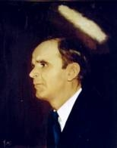
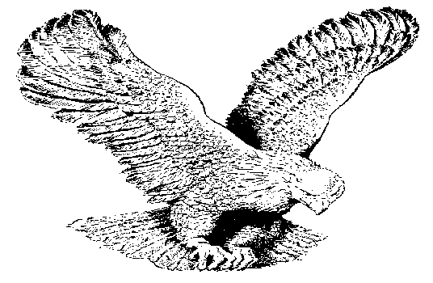
112
FAITH IN JEHOVAH
Faith in the Father, faith in the Son,
Faith in the Holy Ghost, these three are One;
Demons will tremble, and sinners awake;
Faith in Jehovah makes anything shake.

